Slide 1
Network Proposal
Cadets William Born and Kayleigh Stallings

Slide 2
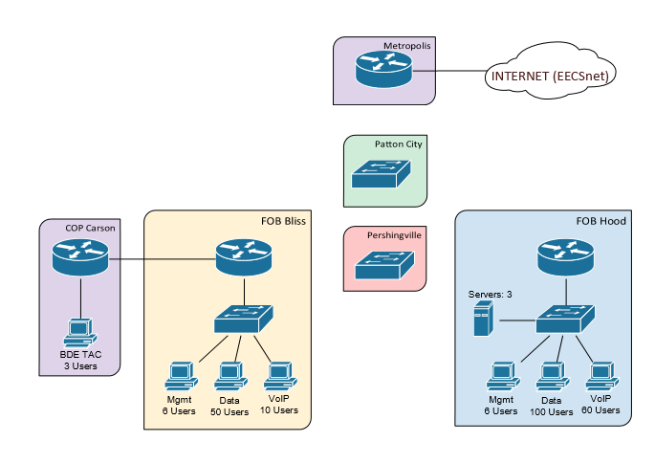
Network Overview

Slide 3
Requirements
All users need internet access
If a link is cut between FOB Bliss and Pershingvill, FOB Bliss should sill have access to all other sites
BDE TAC wants Wi-Fi
Internal users have access to 2 web servers and a DNS server
Only appropriate traffic should be sent to each server
No users from the outside should be able to access the servers or ping the network

Slide 4
Constraints
IP Space= 10.64.62.0/24
Metropolis router IP = 10.64.0.62/24
OSPF must be used between main sites and COP

Slide 5
Network Diagram
Fa0/0.100: 10.64.64.10
Fa0/0.200: 10.64.64.20
Fa0/0.300: 10.64.64.30
Fa0/0.400: 10.64.64.40
Default Gateway: 10.64.0.64

Slide 6
Subnetting Chart
Private Addresses
Location | Network | Subnet Mask | Usable Range | Broadcast
FOB HOOD | 192.168.64.0 | 255.255.255.128 | 192.168.64.1-.126 | 192.168.64.127
FOB BLISS | 192.168.74.0 | 255.255.255.128 | 192.168.74.1-.126 | 192.168.74.127
COP CARSON | 192.168.74.128 | 255.255.255.248 | 192.168.74.129-.135 | 192.168.74.136
Public Addresses
Location | Network
FOB HOOD | 10.64.64.1
FOB BLISS | 10.64.64.2
Pershingville | 10.64.64.3
Location | Network
Patton | 10.64.64.4
Metropolis | 10.64.64.5
Network will utilize PAT to save the limited IP space

Slide 7
Interface Configuration

Slide 8
VLAN Configuration
VLAN Number | VLAN Name | IP on Metropolis
100 | Management | 10.64.64.10
200 | FOB HOOD | 10.64.64.20
300 | FOB BLISS | 10.64.64.30
400 | COP CARSON | 10.64.64.40

Slide 9
Routing

Slide 10
ACLS, NAT and wireless

Slide 11
Layer 2 design

Slide 12
Layer 3 Design

